Slide 1
A Supervised Learning Based Methodology for Cancer Classification
Karlygash, Bermet

Slide 2
Project TimeLine
TASKS |  | START | END | DAYS | STATUS
Discuss Requirements and write proposal |  | 2020-10-01 | 2020-10-11 | 10 | Complete
Set Kick-Off Meeting, Agree on Objectives |  | 2020-10-12 | 2020-10-13 | 1 | Complete
Project Requirements, Project Design |  | 2020-10-14 | 2020-10-18 | 4 | Complete
Data Collection |  | 2020-10-19 | 2020-10-25 | 6 | Complete
Pre-processing |  | 2020-10-26 | 2020-11-10 | 15 | Complete
Feature Extraction |  | 2020-11-11 | 2020-12-15 | 34 | In progress
Feature Reduction (Optional) |  | 2020-12-16 | 2021-01-01 | 16 | Not started
Machine Learning Algorithm |  | 2021-01-02 | 2021-02-10 | 39 | Complete
Performance Evaluation |  | 2021-02-11 | 2021-02-20 | 9 | Complete
Visualization |  | 2021-02-21 | 2021-03-20 | 27 | Not started
Paper writing and submission |  | 2021-03-21 | 2021-04-19 | 29 | Not started
Documentation (User Guide) |  | 2021-04-20 | 2021-04-30 | 10 | Not started
Documentation (Thesis) |  | 2021-05-01 | 2021-05-29 | 28 | Not started
Presentation |  | 2021-05-30 | 2021-05-31 | 1 | Not started

Slide 3
Progress of the Project
Complete
Artificial Neural Network
KNN
Decision Tree
Navie Bayes
Random Forest
Completed
In Progress

Slide 4
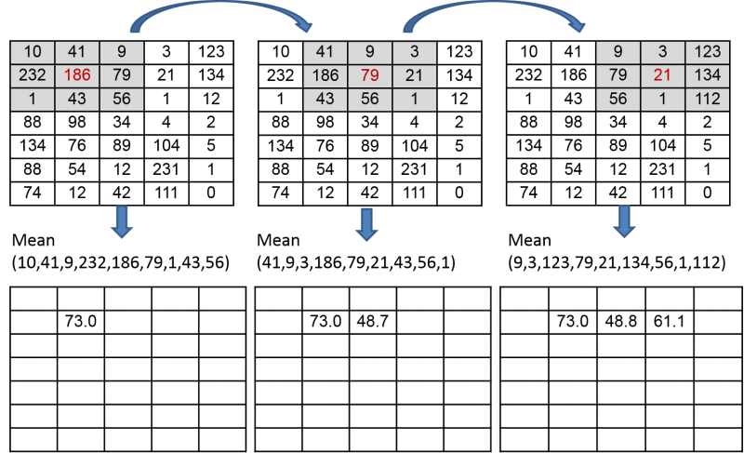
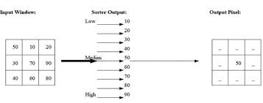
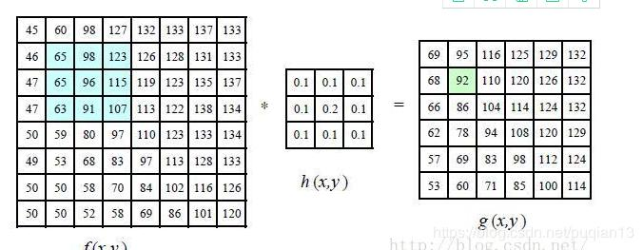
Smoothing Filters
Following are the two import filters that are used for noise removal in medical images.
Mean / Average Filter: Replace each pixel by the average of its neighbors.
Median Filter : Replace each pixel value by the median value of its neighbors

Slide 5
Classification Algorithms
Following are machine Learning algorithms that are used in the proposed work for classification
K-Nearest Neighbor Algorithm
Naïve Bayes Algorithm
Decision Tree Algorithm
Random Forest Algorithm
Artificial Neural Network Algorithm
We have covered the theatrical concepts and implementations of all these algorithms, but due to time limitation I will here only present the Artificial Neural Network.

Slide 6
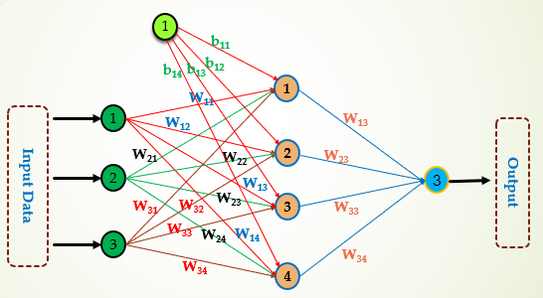
Artificial Neural Network (ANN)
ANN is a supervised machine learning algorithm, inspired by the animal rain work, which can be used for both regression and classification.
An ANN is based on a collection of connected units or nodes called artificial neurons, which loosely model the neurons in a biological brain. Each connection, like the synapses in a biological brain, can transmit a signal to other neurons.
Given algorithm includes input data and an output, which can be represented as one node or some nodes.

Slide 7
The connection between the nodes are called ‘edges’
Neurons and edges typically have a weight that adjusts as learning proceeds.
The weight increases or decreases the strength of the signal at a connection.
Neurons are aggregated into layers: layers may perform different transformations on their inputs; signals travel from the first layer (the input layer), to the last layer (the output layer), possibly after traversing the layers multiple times.

Slide 8
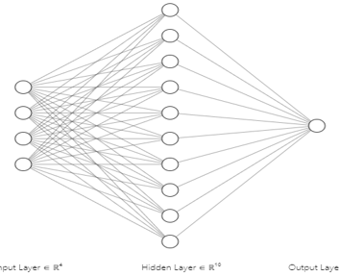
How to Construct a Neural Network?
Case-1: Specification of Neurons in the Input Layer of ANN
Here we have four input variables/features/attributes, hence the number of neurons in the input layer must be 4
Case-3: Specification of Neurons in the out layer
In case of binary classification one neuron will be specified in the output layer
In case of multiclass classification number of neurons will be specified according to number of classes.
Case-2: Specification of Neurons in the out layer
In case of binary classification only one neuron will be specified in the output layer
In case of multiclass classification the number of nodes/neurons in the output layer must be equal to the number of categories/classes in the dependent variable
Case-4: Type of Activation Function on the Hidden Layer Neurons and Output Layer Neurons
Any type of activation function can be applied on the hidden layer’s neurons
In case of binary classification sigmoid or Tanh sigmoid functions can be used in the output layer neurons
In case of multi-class classification SoftMax function is used.
Output
Variables/Features/Attributes
Input Variables/Features/Attributes
Feature1 | Feature2 | Feature 3 | Feature 4 | Class

Slide 9
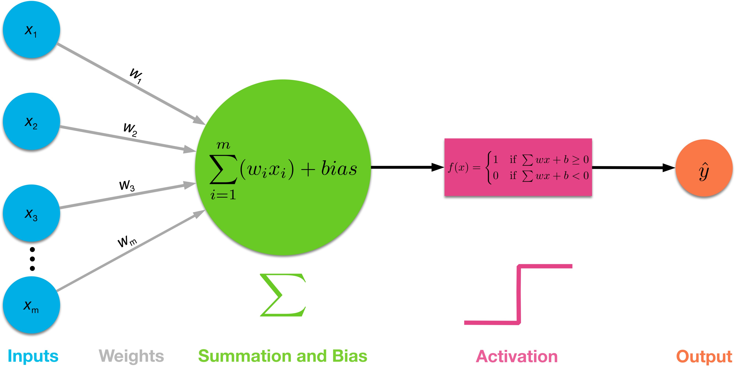
Activation functions
Activation functions are mathematical equations that determine the output of a neural network.
Here, they are needed to transform the output of the neuron.
Activation functions are used in hidden and the output layers of the ANN.
For different data outputs, different activation functions are performed.
Some of the most popular activations functions are: Sigmoid, Tangent, RelU, Softmax

Slide 10
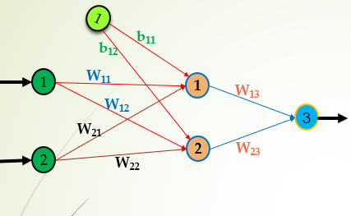

Project adjustments
Since our project is based on the binary classification, the activation function of the ANN is going to be ‘Sigmoid’ activation function.
In this case, there’s only one output node at the output layer, and the hidden layer activation function may be chosen same as an output
There are only two possible outputs of the data

Slide 11
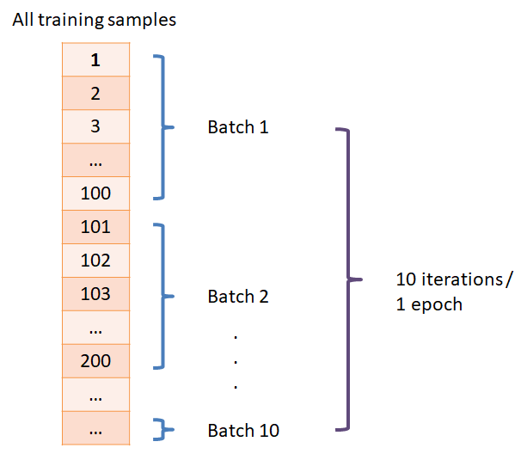
Terminologies
Epoch an epoch refers to one cycle through the full training dataset.
Batch size is the division of training data into packets/samples
Iteration is the number of batches or steps through partitioned packets of the training data, needed to complete one epoch.
Epoch = (Number of iterations * batch size) / total number of instances in training

Slide 12
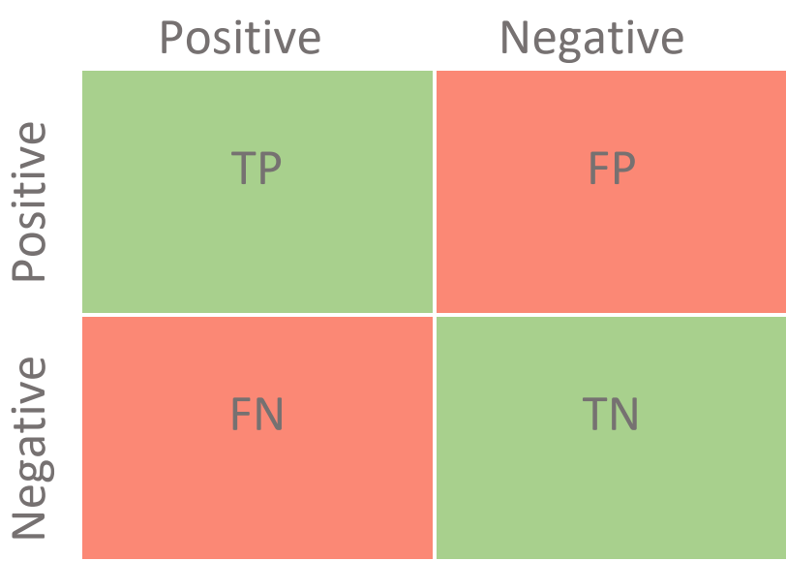



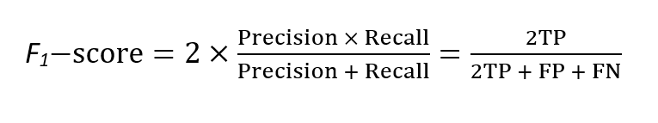
Metrics
The way we check whether our model performed a good job is using different metrics based on the confusion matrix.
The better the metrics results are, the better our model performed its job.

Slide 13
Run Code
Mean and Median Filters
Artificial Neural Network
Decision Tree Classifier
Random Forest Classifier
K-Nearest Neighbor Classifier
Naïve Bayes Classifier
Note: You can remove some algorithms if you want
Here you can mention that we have applied these algorithms on random data.
When we will complete the feature extraction stage and will get data then will apply these algorithms on that data.

Slide 14
Thanks

